Slide 1
Introduction to Wireless Hacking
Josh Rabinowitz

Slide 2
Course Agenda
Day 1 – Overview, Common Protocols
Day 2 – SDR, Tool Setup
Day 3 – Signal Capture, Protocol Deconstruction I
Day 4 – Protocol Deconstruction II, Replay Attacks
Day 5 – Transmission Synthesis, Jamming

Slide 3
Day 1

Slide 4
Day 1 Outline
Wireless Overview
Wireless Attacks
Common Protocols: Wi-Fi
Common Protocols: Zigbee
Other Common Protocols
Q&A

Slide 5

Wireless Hacking: Advantages
There are countless advantages to attacking a target wirelessly, e.g.:
Discretion
Ease of access
Common protocols
Documented vulnerabilities
Insecure configuration
Commercial & open-source tools likely available
Proprietary/generic protocols
Reliant on security-through-obscurity
Predictable or derivative implementations
Wireless technology growing more abundant & changing rapidly

Slide 6
Wireless Hacking: Disadvantages
Some drawbacks to wireless hacking include:
Rapid change means outdated techniques, unmaintained tools (HW & SW)
Learning curve
Tool Development
High-level fundamentals
Networking, cryptography
Low-level fundamentals
E&M, RF Circuitry
Analog & Digital Signal Processing
Regulation/ Legal Risk

Slide 7
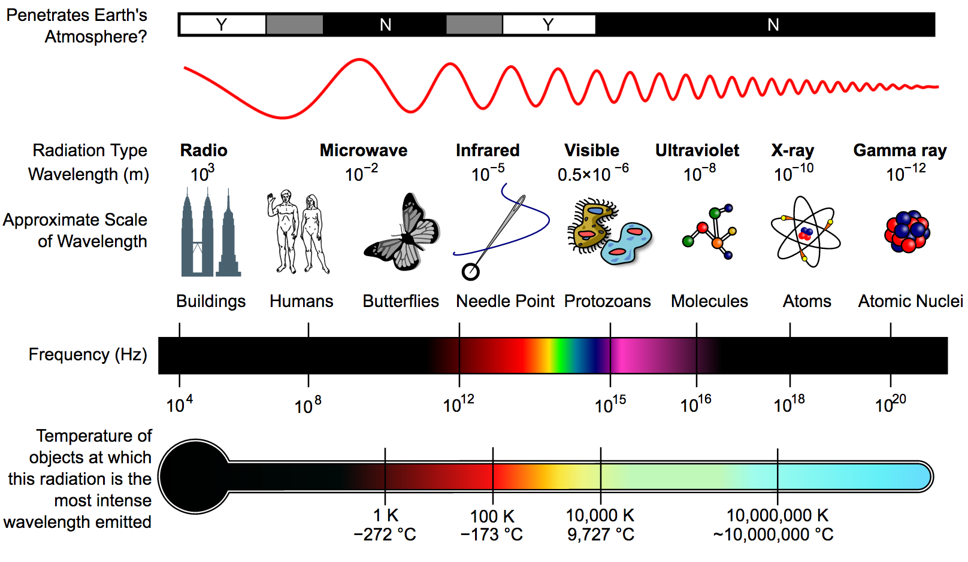
Radio Spectrum
Note: There are various forms of “wireless” technology, such as:
Optical
Sonic
EM Induction
etc.
This course will deal with the most common form of wireless technology, radio waves.
The radio spectrum includes EM waves with frequencies from 3Hz to 3,000GHz (3THz).

Slide 8

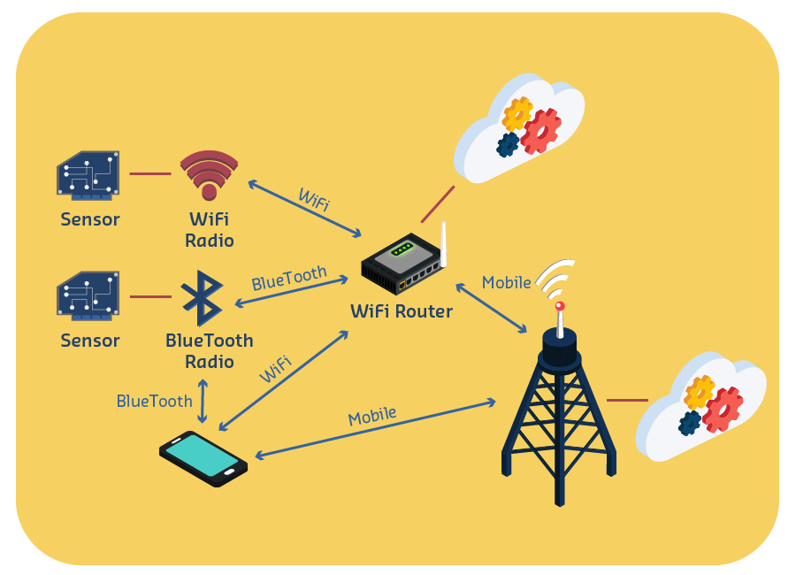
Radio Applications
RF communication is used in nearly every facet of modern life; wireless attacks may target:
Cellular & Wi-Fi networks
Sensor networks & home automation
Wearables, connected health technology
Consumer/Industrial appliances
Automotive technology
Short range – Remotes, keys, fobs, RFID, NFC
Long range – Satellites, aerospace, weather balloons, etc.
Much more…

Slide 9
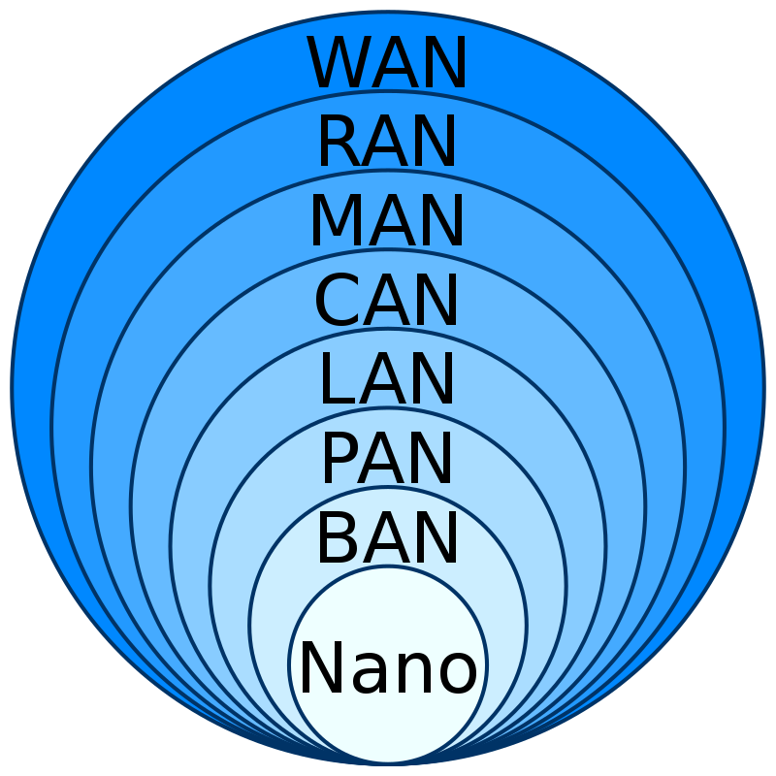
Networks by Spatial Scope
Nanoscale
Body (BAN)
Personal (PAN)
Local (LAN)
Campus (CAN)
Metropolitan (MAN)
Radio access (RAN)
Wide (WAN)

Slide 10
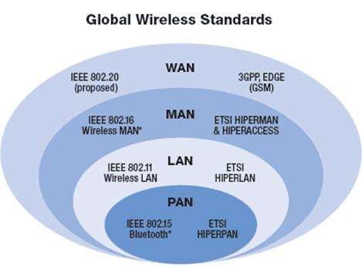
IEEE 802 Family of Standards
Most protocols based on published standards:
802.11 – WLAN (Wi-Fi)
802.11ah - LPWLAN
802.15 – WPAN
802.15.1 – Bluetooth (unmaintained)
802.15.4 – LPWPAN (Zigbee, Thread)
802.15.6 BAN

Slide 11
Communication Protocols
“A communication protocol is a system of rules that allows two or more entities of a communications system to transmit information via any variation of a physical quantity. The protocol defines the rules, syntax, semantics, and synchronization of communication and possible error recovery methods. Protocols may be implemented by hardware, software, or a combination of both.”

Slide 12
Communication Protocols
Implementations vary, but a typical protocol is based on:
Strict, layered designs
Formal specifications, Standard bodies
Networks, topologies
Data formats, addressing, routing
Error detection; ACK’s, timeouts, retries
Sequence/flow control, synchronization
Where protocols differ:
RF characteristics – range, power, interference, etc.
Published vs. proprietary design
HW/SW implementation
OSI layers covered
Network Topology
Applications

Slide 13
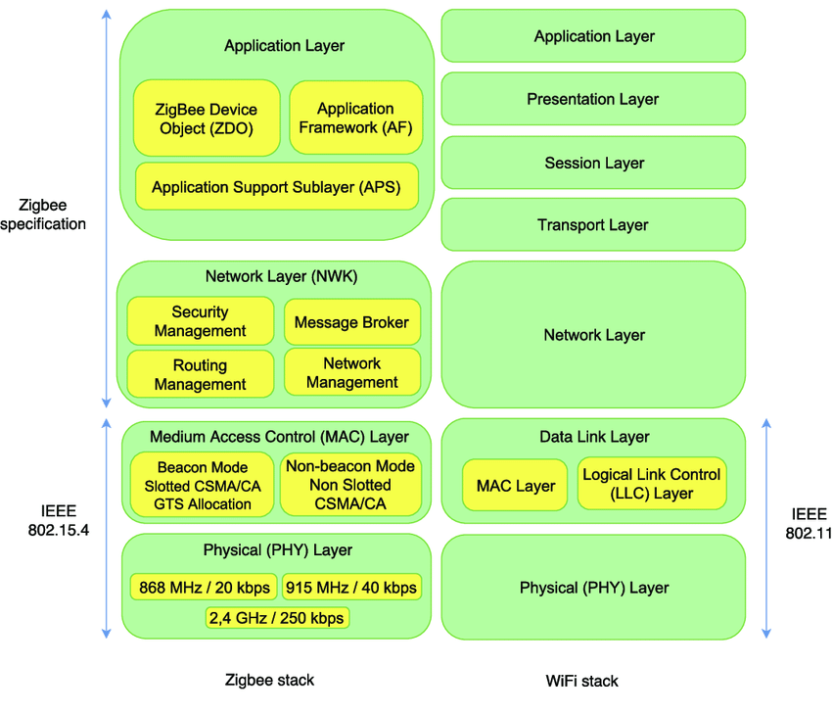
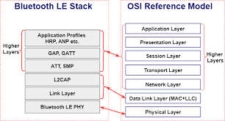
Communication Protocols
Comparing by stack layers:

Slide 14
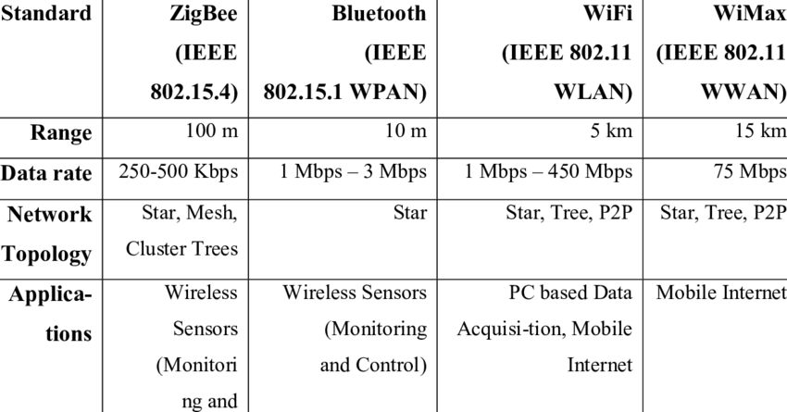
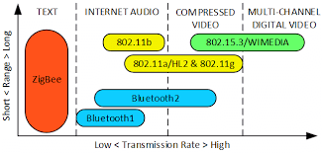
Communication Protocols
Comparing by other metrics:

Slide 15
Day 1 Outline
Wireless Overview
Wireless Attacks
Common Protocols: Wi-Fi
Common Protocols: Zigbee
Other Common Protocols
Q&A

Slide 16
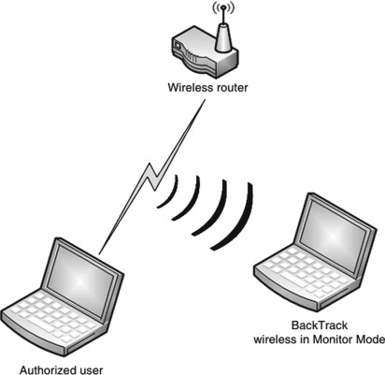
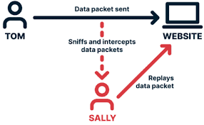
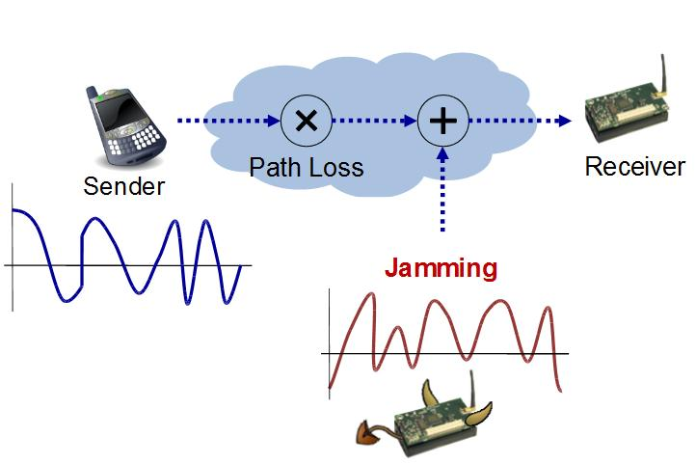
Basic Wireless Attacks
Wireless attacks come in many forms, often dependent on the specific technology
Café Latte → Wi-Fi
Bluesnarfing → Bluetooth
Etc.
Most attacks involving wireless communication can be classified under three basic types:
Sniffing: capturing wireless transmissions to understand/decode sensitive data
Injection/Replay-based attacks: re-transmitting captured data (or synthesizing ad-hoc); includes hijacking, impersonation, IV attacks, etc.
Jamming: Causing interference to prevent a successful transmission; essentially a DoS
Some attacks are a combination of these (e.g., the “Roll-Jam”, discussed later)

Slide 17
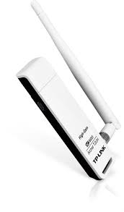
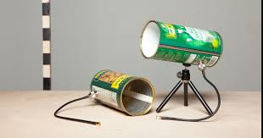
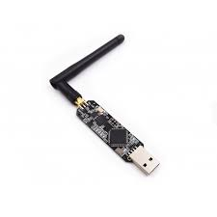
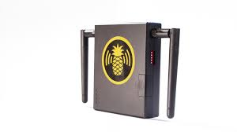
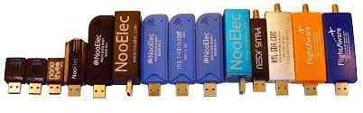
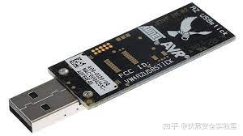
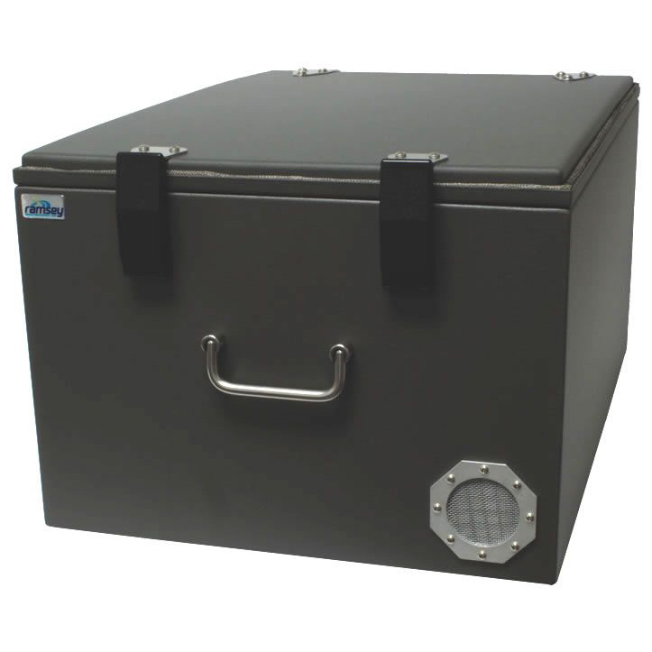
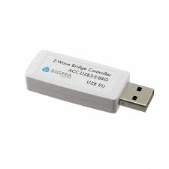
RF Hacker’s Toolkit
Wireless Dongles
GNU Radio
SDR Receivers/Transmitters
Proprietary RF Modules & Software
RF Shielding Cage
Waveguides/Antennas
Python
Scapy, Cryptography, Matplotlib, etc.
GQRX, Inspectrum, BinViz
Fuzzer-testers, protocol analyzers
Pineapple, Femtocell, etc.

Slide 18
Attack Process
Typical high-level approach:
Do we know the protocol in use?
Tool(s) available?
Run Attack
Develop Tool (if possible)
Identify or Deconstruct Protocol

Slide 19
Attack Process
For a common protocol with readymade tools, the ‘wireless’ part of an attack is relatively straightforward…
Do we know the protocol in use?
Tool(s) available?
Run Attack
Develop Tool (if possible)
Identify or Deconstruct Protocol

Slide 20
Attack Process
(1)
(2)
Examples:
(Protocol)
Wi-Fi
Bluetooth
Zigbee
Z-Wave
(SW; HW)
Aircrack-ng tool suite; external Wi-Fi adapter
‘Bluez’ stack; BT dongle
Killerbee platform; Apimote, RZ Raven
Killerzee, Zniffer; UZB3
Follow documentation
Run attack commands
(3)
(4)

Slide 21
Day 1 Outline
Wireless Overview
Wireless Attacks
Common Protocols: Wi-Fi
Common Protocols: Zigbee
Other Common Protocols
Q&A

Slide 22
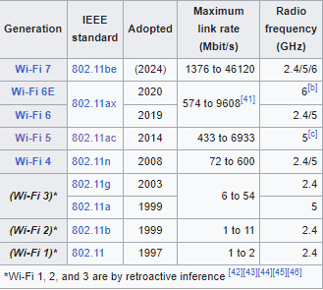
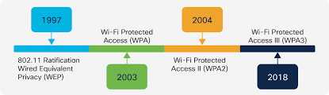
Wi-Fi: Overview
Family of Wireless LANs based on IEEE 802.11 standard
Encryption: WEP, WPA (I/II/III)

Slide 23
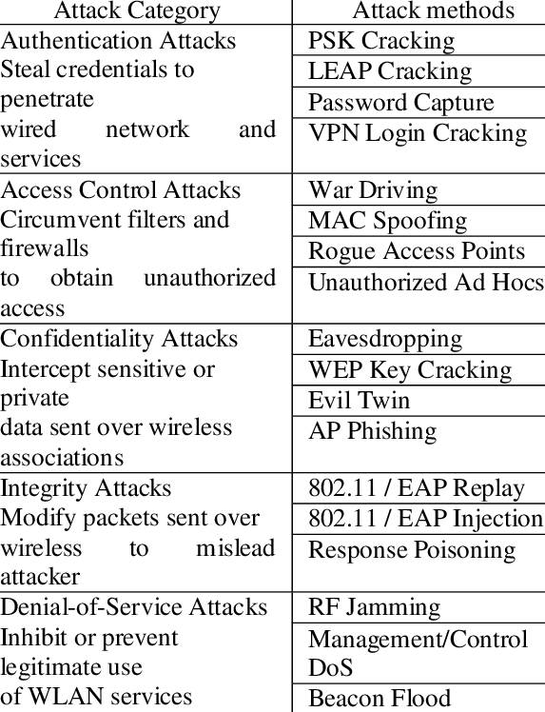
Wi-Fi: Common Attacks
Packet Sniffing
Cracking Encryption
Man-in-the-middle
Evil Twin/Wi-Phishing
Rogue AP
Spoofing
Café Latte
Denial-of-Service
Etc.

Slide 24
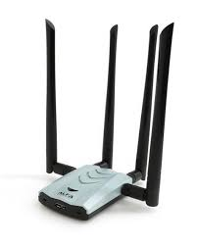
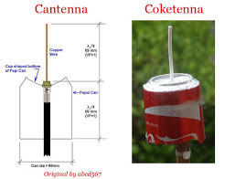
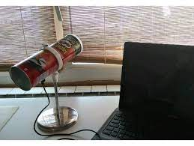
Wi-Fi: Common Tools
Hardware:
USB network adapter
Software:
Wireshark – monitoring traffic
Aircrack-ng – de-authentication, cracking & analysis
Other tools:
Wi-Fi Pineapple – wireless auditing platform
“Cantenna” – homemade directional waveguide
Rogue AP’s
Vulnerable/test routers

Slide 25
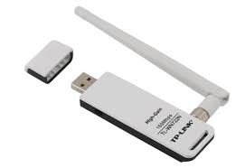
Wireless Network Adapters
Pentest-friendly adapters (as of 2023):
https://kalitut.com/usb-wi-fi-adapters-supporting-monitor/
Common chipsets:
Atheros, Ralink, Realtek
Example: TP-Link TL-WN722N (~$30)
Chipset: Atheros AR9271
Standards: 802.11b, 802.11g, 802.11n
Frequency range: 2400-2483.5 MHz
Transmitter power: 20 dBm
Antenna : removable omnidirectional antenna (RP- SMA)

Slide 26

Aircrack-ng
Network software suite consisting of detector, packet sniffer, WEP and WPA/WPA2-PSK cracker
Most common tool for analyzing 802.11 wireless LANs
Works with any wireless adapter whose driver supports “Monitor Mode” (see next slide)
https://www.aircrack-ng.org/
Install with: “apt-get install aircrack-ng”

Slide 27
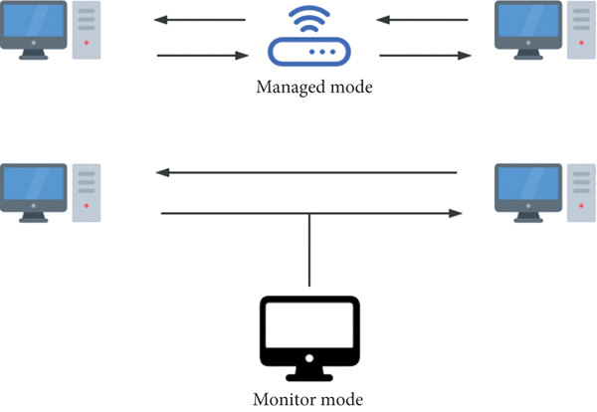
Monitor Mode
Before attacking Wi-Fi networks, adapter must be in Monitor Mode
Normally, wireless card will check ethernet frames and discard unwanted packets
Monitor mode means our wireless card intercepts all traffic, regardless of association

Slide 28
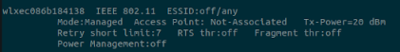
Monitor Mode
To start wireless interface in monitor mode:
Plug adapter into USB port
Use “iwconfig” to find interface
Notice Mode is “Managed” – we want this to say “Monitor”

Slide 29
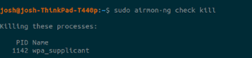
Monitor Mode
Next:
Kill blocker processes using “sudo airmon-ng check kill”
Note: this will turn off Linux network manager!
To turn back on: “sudo systemctl restart NetworkManager”

Slide 30
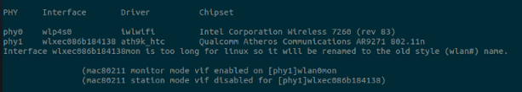
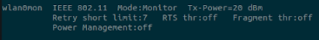
Monitor Mode
Finally:
Run “sudo airmon-ng start [interface]”
Run “iwconfig” once more to check…

Slide 31
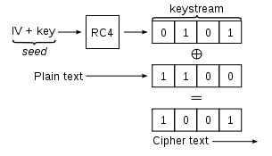
Simple WEP Crack
Overview
Basic WEP encryption: RC4 keystream XORed with plaintext
40-bit key concatenated with 24-bit IV
24 bits not enough to prevent repetition
On busy network, takes minutes to crack
Automated by tools such as Aircrack-ng

Slide 32
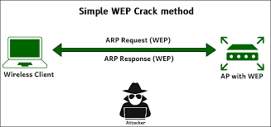
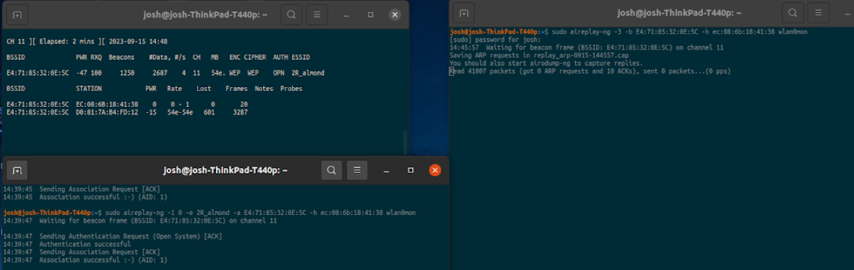
Simple WEP Crack
Steps:
Test injection capability
Begin IV collection
Fake authentication with AP
Replay ARP requests
Crack key using IVs

Slide 33
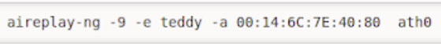
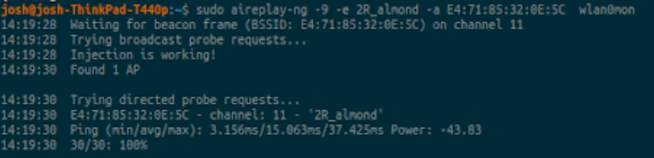
Simple WEP Crack
Step 1: Test injection capability
aireplay-ng -9 –e [AP name] –a [BSSID] [interface]
Determines whether we are close enough to AP for packet injection

Slide 34
Simple WEP Crack
Step 2: Begin IV collection
airodump-ng –c [AP channel] –bssid [BSSID] –w [capture file] [interface]
Capture initialization vectors (IV’s) coming from target AP
(1st console)

Slide 35
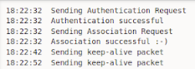
Simple WEP Crack
Step 3: Fake authentication with AP
aireplay-ng –1 0 –e [AP name] –a [BSSID] –h [interface address] [interface]
For injection to work, our MAC must be associated with the AP
(2nd console)

Slide 36
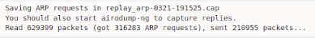
Simple WEP Crack
Step 4: Replay ARP requests
aireplay-ng –3 –b [BSSID] –h [interface address] [interface]
Reinject ARP requests; AP will rebroadcast and generate new IV’s
(3rd console)

Slide 37
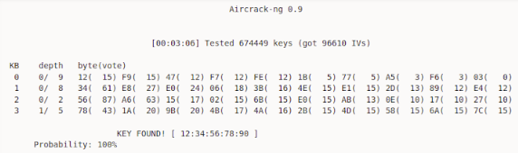
Simple WEP Crack
Step 5: Crack key using IVs
aircrack-ng –b [BSSID] [capture file(s)]
Obtains WEP using IV’s gathered from previous steps
(3rd console)

Slide 38
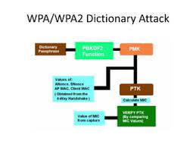
WPA/WPA2 Crack
Overview:
Unlike WEP, key is not static
Can crack pre-shared key using dictionary attack
Must first capture client handshake

Slide 39
WPA/WPA2 Crack
Steps:
Collect authentication handshake
De-authenticate wireless client (optional)
Crack pre-shared key using authentication handshake

Slide 40
WPA/WPA2 Crack
Step 1: Collect authentication handshake
airodump-ng –c [channel] –b [BSSID] –w [capture file] [interface]
Listen for 4-way handshake between client and target AP

Slide 41
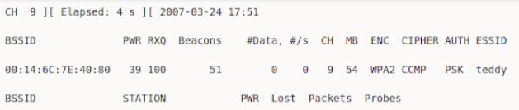
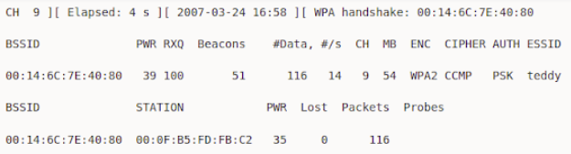
WPA/WPA2 Crack
Step 1: Collect authentication handshake
Handshake collected

Slide 42
WPA/WPA2 Crack
Step 2: De-authenticate wireless client (optional)
aireplay-ng –0 1 –a [BSSID] –c [client to de-auth] [interface]
If needed, this will de-authenticate a client associated with the AP
By reauthenticating, they’ll generate the 4-way handshake we need
(2nd console)

Slide 43
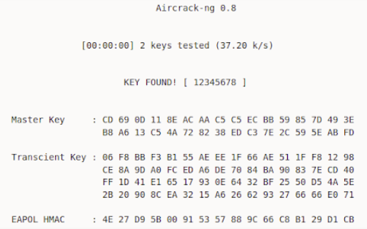
WPA/WPA2 Crack
Step 3: Crack pre-shared key using authentication handshake
aircrack-ng –w [password list] –b [BSSID] [capture file(s)]
Checks wordlist against captured handshake to obtain PSK

Slide 44
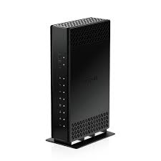
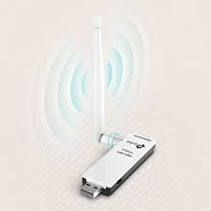
Exercise
Goal: Use Aircrack-ng to crack Wi-Fi encryption
(Use either lab Wi-Fi or test router; should be provided with adaptor)
Install aircrack-ng suite
Plug in USB adapter & set in Monitor Mode
Determine test network encryption type (WEP, WPA, etc.)
Use aircrack-ng suite to obtain network key
(Note: if using dictionary attack, create wordlist file containing network password)

Slide 45
WPA/WPA2 vs. WPA3
WPA/WPA2 : Flaws | WPA/WPA2 |  | WPA3: Fixes
Protocols susceptible to off-line analysis | Weak passwords crackable w/Aircrack Suite | weak passwords crackable w/Aircrack Suite | Each PW guess requires interaction, placing temporal limit on attempts***
Lack of forward secrecy | PSK allows decryption of all associated traffic, future & past |  | SAE provides perfect forward secrecy; adversary w/password cannot recover earlier traffic, session keys, etc.
Group Temporal Key (GTK) vulnerabilities | “Hole196” | Authenticated attacker (possessing GTK) can perform MiTM or DoS | Implements client isolation to prevent using GTK
 | Insecure random number generator (RNG) | Quick GTK recovery, allows injection and unicast decryption
WPS PIN Recovery | Fairly quick password recovery | Fairly quick password recovery | Alternative configuration replaces WPS
“KRACK” Attack (Key Reinstallation) | Retransmit nonce in replay attack to obtain full keychain |  | Can’t hijack session w/out key (patches now prevent retransmitting nonce as well)
WPA3 – STILL vulnerable:
Rogue AP
Evil Twin
ARP Spoof
SSL Strip
DNS Spoof
DoS
***Downgrade & Side-Channel attacks
e.g. “Dragonblood”
Some vulnerabilities not patched for backward compatibility, e.g. hash-to-group function

Slide 46
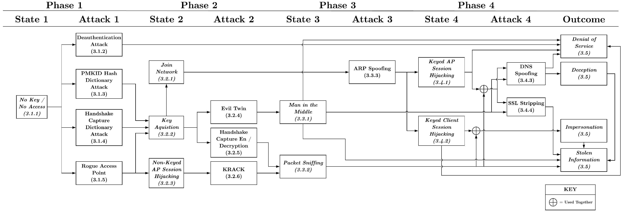
Attack Flow Diagram: WPA2-PSK

Slide 47
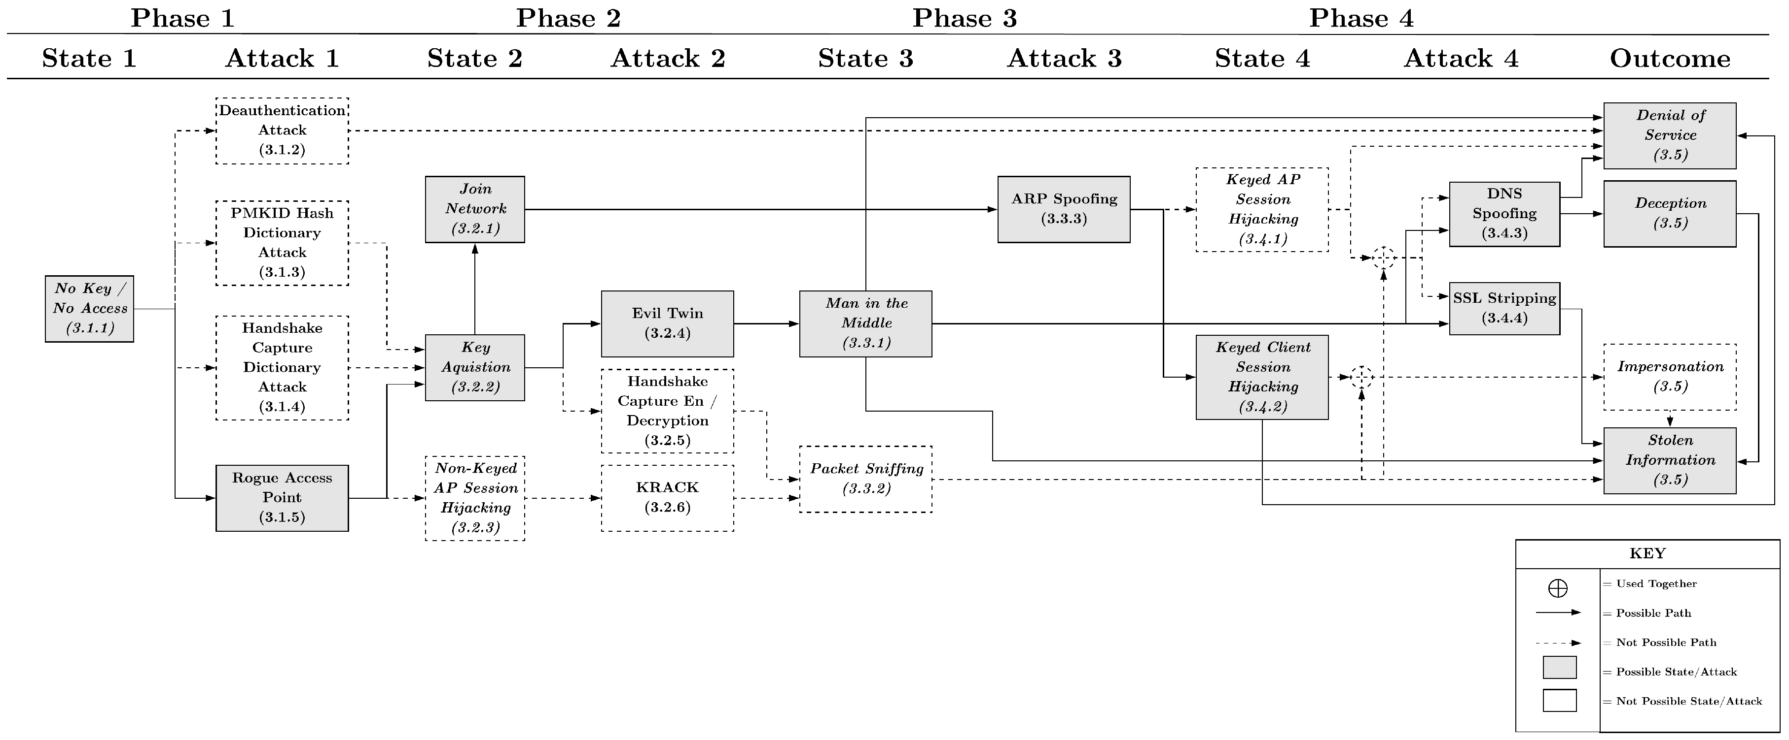
Attack Flow Diagram: WPA3

Slide 48
Day 1 Outline
Wireless Overview
Wireless Attacks
Common Protocols: Wi-Fi
Common Protocols: Zigbee
Other Common Protocols
Q&A

Slide 49
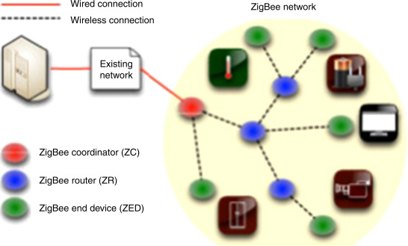
Zigbee: Overview
Based on IEEE 802.15.4 specification for PAN
Low-power mesh networks for home automation, medical device data collection, etc.

Slide 50
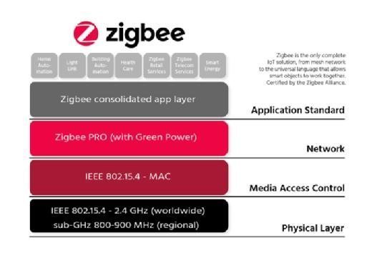
Zigbee: Overview
Stack layers:
(Note sub-GHz ISM band allocation varies by geography)

Slide 51
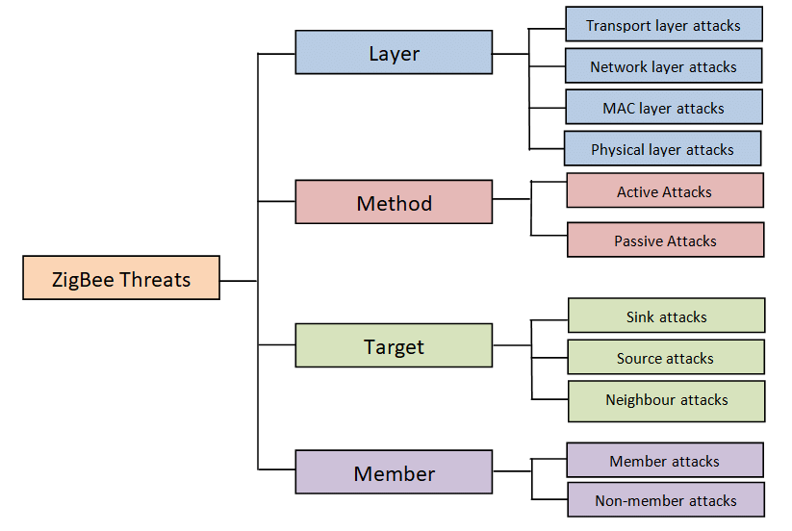
Zigbee: Common Attacks
Packet Sniffing
Cracking Encryption
Replay
Tracking
Denial-of-Service
Application-level attacks
*Notice most threats are not unique to Zigbee

Slide 52



Zigbee: Common Tools
Hardware:
ApiMote by River Loop Security
Atmel AVR RZ Raven
Texas Instruments CC2531
Software:
Killerbee
https://github.com/riverloopsec/killerbee
Complete toolkit; can be combined with Scapy to build custom tools (injectors, fuzzers, etc.)
Bumblebee
https://github.com/virtualabs/cc2531-killerbee-fw
Killerbee-compatible firmware for TI CC2531
ZigDiggity
https://github.com/BishopFox/zigdiggity
Limited toolkit; requires Raspbee shield + Raspi

Slide 53

Killerbee
Framework for auditing Zigbee and IEEE 802.15.4 Networks
Installation:
(See https://github.com/riverloopsec/killerbee)

Slide 54
Killerbee
Most important tools:
zbid - Identifies available interfaces that can be used by KillerBee and associated tools.
zbwireshark - Similar to zbdump but exposes a named pipe for real-time capture and viewing in Wireshark.
zbdump - A tcpdump-like took to capture IEEE 802.15.4 frames to a libpcap or Daintree SNA packet capture file. Does not display real-time stats like tcpdump when not writing to a file.
zbreplay - Implements a replay attack, reading from a specified Daintree DCF or libpcap packet capture file, retransmitting the frames. ACK frames are not retransmitted.
zbstumbler - Active ZigBee and IEEE 802.15.4 network discovery tool. Zbstumbler sends beacon request frames out while channel hopping, recording and displaying summarized information about discovered devices. Can also log results to a CSV file.

Slide 55


Exercise
Goal: Sniff traffic from Zigbee device using Killerbee tools
(Should be provided with Zigbee dongle & Bulb/Switch set)
Target Device: HEIMAN Smart Bulb & Dimmable Switch from Amazon
Pairing instructions:

Slide 56


Exercise
Getting started:
Plug dongle into USB port
Use ‘zbid’ to list devices
Find target device channel using ‘zbstumbler’
See Man pages for help on command usage!
Things to try:
Sniff/capture pairing process
Sniff different commands from the remote
Investigate in wireshark (‘zbwireshark’)
Replay attacks using ‘zbreplay’

Slide 57
Day 1 Outline
Wireless Overview
Wireless Attacks
Common Protocols: Wi-Fi
Common Protocols: Zigbee
Other Common Protocols
Q&A

Slide 58






Other Common Protocols
Bluetooth/BLE Tools:
BT dongle + Linuz ‘bluez’ stack
Hcitool, gattool, wireshark
Z-Wave Tools:
Dongle: ACC-UZB3-U-STA
Software (by Silicon Labs):
Z-Wave PC Programmer
“Zniffer” Sniffing Utility
LoRa Tools:
Dongle: Microchip RN2483, Pycom LoPy
python-loranode

Slide 59
Day 1 Outline
Wireless Overview
Wireless Attacks
Common Protocols: Wi-Fi
Common Protocols: Zigbee
Other Common Protocols
Q&A

Slide 60
Day 2

Slide 61
Day 2 Outline
Attack Process Revisited
Example: Garage Door
Example: Car Keys
Tool Setup
Q&A

Slide 62
Day 2 Outline
Attack Process Revisited
Example: Garage Door
Example: Car Keys
Tool Setup
Q&A

Slide 63
Attack Process Revisited
Recall the high-level approach from Day 1:
Do we know the protocol in use?
Tool(s) available?
Run Attack
Develop Tool (if possible)
Identify or Deconstruct Protocol

Slide 64
Attack Process Revisited
Now we’ll broaden the approach by moving beyond common protocols and readymade tools…
Do we know the protocol in use?
Tool(s) available?
Run Attack
Develop Tool (if possible)
Identify or Deconstruct Protocol

Slide 65
Extending Capabilities
Day 1 introduced common protocols and their specific tools
As these protocols evolve or phase out of use, software tools go unmaintained, hardware becomes obsolete, and certain techniques becomes less practical “in the wild”; examples:
ApiMote, RZ Raven hardware (Zigbee) → obsolete
Writeable GATT characteristics (Bluetooth) → vulnerability now uncommon
Zniffer utility (Z-Wave) → unmaintained
Skilled wireless hackers focus on core elements that don’t change:
Basic RF concepts
How to assess/understand new protocols
How tools are developed, modified, or chained
Designing fuzzers, injectors, jammers, etc.
(Building-blocks for the tools & frameworks we’ve seen up to this point)

Slide 66
Extending Capabilities
For digging deeper, a more practical set of tools is needed
These typically form the “building blocks” of common tools and frameworks:
Python (most open-source RF tools utilize python-based modularity)
Scapy, Cryptography, Matplotlib, etc.
SDR
GNU Radio
osmocom, scapy-radio, etc.
Custom flowgraphs/plots
Compatible Receivers/Transmitters
Other tools/resources
Published protocols
Modular fuzzing platforms
Wordlists, monitors, jammers, etc.

Slide 67


Scapy
Many wireless hacking tools built using Scapy: https://scapy.net/
Combines with:
Python modules like cryptography/matplotlib
Community of open-source libraries, protocol definitions, etc.
SDR tools (see next slide)
Recall ‘zbscapy’ from killerbee framework!

Slide 68

Software-Defined Radio
Software-defined radio (SDR): radio communication system where components that conventionally have been implemented in analog hardware (e.g. mixers, filters, amplifiers, modulators/demodulators, detectors, etc.) are instead implemented by means of software on a personal computer or embedded system

Slide 69


GNU Radio
Free software development toolkit that provides signal processing blocks to implement software-defined radios and signal processing systems
Can be used with external radio frequency (RF) hardware to create software-defined radios, or without hardware in a simulation-like environment
Widely used in hobbyist, academic, and commercial environments to support both wireless communications research and real-world radio systems

Slide 70

GNU Radio
GNU Radio applications themselves are generally known as "flowgraphs", which are a series of signal processing blocks connected together, thus describing a data flow
Creates C++ or Python applications, can be modular/chained with other tools
Large community of open-source graphs, blocks, libraries etc. including:
GR 802.11 projects
GR Bluetooth stack
Gr-lora block (LoRaWAN, LoRaPHY)
Osmocom (osmocomBB, OpenBTS, etc.)
Scapy-radio (see next slide)

Slide 71

Scapy-radio
By Bastille Research: https://github.com/BastilleResearch/scapy-radio
Modified version of Scapy that can leverage GNU Radio to handle a SDR card
Includes flow & blocks written to handle several protocols:
Bluetooth LE (advertising only)
802.15.4 (used by Zigbee, Xbee, 6LoWPAN)
ZWave (European frequency, 868MHz)

Slide 72

GNU Radio: Examples
Wireless Measurement and Experimentation projects: https://www.wime-project.net/
Check out some of their advanced SDR projects
Useful protocol-based utilities all created with GNU Radio
Example shown on right: DIY Zigbee Transceiver

Slide 73


GNU Radio: Examples
UL assessed the security of a medical device with a LoRa (“LoRaWAN”) RF module for long distance communication
Used Python to develop packet-decoder, fuzzer and jammer
HackRF One + GNU Radio used to imitate LoRa’s proprietary CSS-based modulation

Slide 74





SDR: Compatible Hardware
Choosing an external radio: https://wiki.gnuradio.org/index.php/Hardware
Commonly used:
RTL-SDR (~$10)
Made from TV tuners; mostly Realtek RTL2832
Integration via gr-osmocom
Typical Range: 25 MHz ~ 1750 MHz
YARD Stick One (~$125)
Sub-GHz, half duplex
HackRF One (~$350-400)
Range: 1MHz to 6GHz
Half-duplex transceiver
Integration via gr-osmocom or gr-soapy
Others: Lime SDR, Nuand BladeRF, Ettus USRP (>$1000)

Slide 75
Radio Selection
Protocol-based USB Dongles
Pro’s
Typically cheap, small
Protocol-specific → Plug’n’play convenience
Firmware often preinstalled
Con’s
Protocol-specific → quickly obsolete
Dedicated Hardware, limited functionality
Tedious to re-flash
Proprietary RF modules limit control
Compatibility issues
Software-Defined Radio (SDR) Receivers/Transmitters
Pro’s
Good bandwidth
Channels (Tx+Rx)
Versatile (reusable) Hardware
Can replace most dongles
Build practical radio skills
Complete control!
Never obsolete
One radio for all protocols…
Con’s
Mostly expensive
Learning Curve
Driver issues

Slide 76

PHY Layer Demystified
We now understand the building blocks needed to develop tools for new/existing protocols
How do we identify or characterize radio communication when approaching a new or unknown protocol?
Must be familiar with basic, low-level RF concepts such as:
Modulation
Encoding (“Line Code”)

Slide 77


Telecomm. Terms
Modulation
Shaping of a signal to convey information
Vary properties of a periodic waveform (carrier signal) using separate signal containing transmitted data (message/modulation signal)
Many forms of modulation w/specific applications or strengths
“Keying” – representing digital message as analogue waveform (named after Morse Code)

Slide 78

Telecomm. Terms
Modulation
Basic forms of digital modulation:
Phase-shift keying
Frequency-shift keying
Amplitude-shift keying
Quadrature amplitude modulation
All just different ways to represent bits!
With experience, RF hackers come to recognize common forms of modulation and their applications

Slide 79

Telecomm. Terms
Encoding (“Line Coding”)
Encoding is how we represent digital data sent via telecommunication
NOTE: “unipolar encoding” means essentially no encoding
Carrier wave = binary 1
No wave = binary 0
Short-distance RF devices often have data encoded, e.g., as Manchester code
Bits represented by transitions
More overhead, but better error detection
Again – will learn to recognize these and when/why they’re used
Until then, keep visual reference handy!

Slide 80

Telecomm. Terms
Encoding (“Line Coding”)
Example of Manchester encoded data:

Slide 81
Common Protocols
Comparing RF Characteristics:
Note how these familiar protocols differ at the bottom layers of the protocol stack:
Technology | Band | Modulation | Encoding
BLE | 2.4GHz | GFSK | DSSS
Zigbee | 868/915MHz | BPSK | DSSS
 | 2.4GHz | OQPSK
Z-Wave | 868/915MHz | FSK | Manchester
LoRa | 868/915MHz | Proprietary CSS | ECC
Sigfox | 868/915MHz | DBPSK, GFSK | -
NFC | 13.56MHz | ASK | Manchester, Modified Miller

Slide 82
Generic RF Attack Process
Steps:
Locate signal in RF band
Capture/record signal for inspection
Identify modulation scheme
Identify encoding scheme
Determine baud rate
Extract/document symbols
Reverse-engineer protocol format
The following slides will explore how this process fits into a realistic attack scenario

Slide 83
Day 2 Outline
Attack Process Revisited
Example: Garage Door
Example: Car Keys
Tool Setup
Q&A

Slide 84




Example: Garage Door
Attack Scenario
To demonstrate the power of wireless attacks, consider the following scenario:
Victim is leaving the house, and closing their garage door
Attacker is nearby with a laptop and radio transceiver
How can the attacker gain access to the victim’s garage (and possibly their residence)?

Slide 85

Example: Garage Door
Attack Scenario
The attacker can utilize a replay attack, as shown on the right…
Let’s investigate the attacker’s process at a high level; by the end of this course, you will understand how to carry out such an attack
We’ll introduce some important concepts along the way

Slide 86

Example: Garage Door
Where to start?
In this scenario, the attacker must ‘impersonate’ the RF transmission that opens the garage
Suppose the attacker can identify the victim’s garage remote – with a target device, where do we begin capturing RF signals?
To start, we must determine the frequency of the transmission we are capturing

Slide 87

Example: Garage Door

Slide 88
Example: Garage Door
FCC ID Lookup
In the US, devices which emit RF energy are regulated by the FCC
Any manufactured radio, remote, fob, smart-bulb, etc. must prove compliance
An FCC ID will be visible somewhere on the device and/or packaging
So – how does this help an attacker determine the frequency?

Slide 89


Example: Garage Door
Attacker can look up the FCC ID to find a certification on the agency’s website
Details are publicly available!

Slide 90

Example: Garage Door
FCC ID Lookup
Shown below is the result; by opening the “Exhibits”, the attacker will find detailed testing reports
Try looking this up as a quick exercise – click both Detail/Summary links to see the various graphs and specifications!
Information available will vary by product…

Slide 91
Example: Garage Door
Determining Frequency
In this case, what the attacker needs is already displayed
Attacker has “located” target signal on the radio band…
Alternatively, one could utilize spectral analysis (frequency scanning) to locate a transmission of interest
RF hackers will anticipate common frequencies/bands based on target device; will vary based on geography!

Slide 92



Example: Garage Door
Signal Deconstruction
Knowing the target band, attacker can now capture and inspect the victim’s RF transmission
Day 2 we will study these tools & techniques in detail

Slide 93

Example: Garage Door
Modulation
With a clear look, attacker recognizes modulation as “On-Off Keying”
(To extract raw data, an attacker must separate message & carrier signals)

Slide 94
Example: Garage Door
Modulation
OOK is the simplest form of ASK (Amplitude-Shift Keying)
Turning a transmitter On/Off, like Morse code
Very common in short-distance communication
As with frequency, RF hackers will recognize common forms of modulation and their applications

Slide 95

Example: Garage Door
Encoding
Attacker “demodulates” signal and extracts the raw digital data
By inspection, attacker can see that “unipolar” encoding (line code) is used
See encodings on next slide for reference…

Slide 96


Example: Garage Door
Documenting Protocol
From one ‘click’ of the victim’s remote, our attacker now knows:
Tx frequency, modulation, encoding
Clocking/baud rate
Burst/Command structure → raw Tx data
Attacker has effectively reverse-engineered the remote’s proprietary RF protocol

Slide 97
Example: Garage Door
Replaying Signal
As stated, the attacker in this scenario can simply play the initial recording using their own radio to open the garage
This would be the standard “replay attack”
As we’ll see later, real wireless attacks often require going further:
Reversing/deconstructing protocol
Crafting or modifying transmissions

Slide 98

Example: Garage Door
Crafting From Scratch
Having deconstructed the transmission, the attacker could also recreate it using basic Software-Defined Radio (SDR) tools
We’ll learn to do this as well using GNU Radio
Will explore why these techniques are required for attacks (or testing!)

Slide 99

Example: Car Keys
Suppose the attacker from Scenario 1 wants control of the victim’s car in addition to the garage
Can apply the same techniques from previous attack

Slide 100



Example: Car Keys
Real example:
Jaguar XK8 (1998)
Frequency: 315MHz
Labeled on remote; could also look up FCC ID
Common for key fobs – again, RF hackers will come to know common frequencies
OOK (ASK) modulation again

Slide 101



Example: Car Keys
Real example:
Hyundai Sonata (2012)
Frequency: 315MHz
Same as first example
Modulation: This one uses Frequency-Shift Keying (FSK)
Encoding: Manchester
(Can you see how the modulation/encoding are evident in the images below?)

Slide 102
Example: Car Keys
Suppose the attacker from Scenario 1 wants control of the victim’s car in addition to the garage
Can apply the same techniques from previous attack … sometimes!!!

Slide 103
Example: Car Keys
The replay attack shown will not work for certain (generally, newer) key fobs, as security is improving
Day 3 will look at how this attack is mitigated, and how current defenses can in turn be bypassed…

Slide 104
Day 2 Outline
Attack Process Revisited
Example: Garage Door
Example: Car Keys
Tool Setup
Q&A

Slide 105

Tool Setup
Required Hardware:
Laptop running recent version of Linux (Ubuntu, Kali, etc.) – not provided
‘HackRF One’ by Great Scott Gadgets – should be provided
Target Device(s)
ZAP Remote + Outlets
Should be provided

Slide 106

Tool Setup
Required Software:
GQRX
used for waterfall plot & recording raw I/Q data
Install with “sudo apt-get install gqrx-sdr”
Inspectrum
Visual inspection of captures & symbol extraction
Install with “sudo apt-get install inspectrum”
GNU Radio
(GUI application called GNU Radio “Companion”)
Processing tool for Software-Defined Radio (SDR)
Install with:
sudo add-apt-repository ppa:gnuradio/gnuradio-releases
sudo apt-get update
sudo apt-get install gnuradio

Slide 107
Day 2 Outline
Attack Process Revisited
Example: Garage Door
Example: Car Keys
Tool Setup
Q&A

Slide 108
Day 3

Slide 109
Day 3 Outline
Target Device
Product Overview
Product Setup
Transmission Frequency
Capture
Receiver Setup
Performing Capture
Signal Deconstruction
Inspecting Recording
Symbol Extraction
Documenting Commands
Q&A

Slide 110
Day 3 Outline
Target Device
Product Overview
Product Setup
Transmission Frequency
Capture
Receiver Setup
Performing Capture
Signal Deconstruction
Inspecting Recording
Symbol Extraction
Documenting Commands
Q&A

Slide 111


Product Overview
ZAP Remote Outlet Switch
By: Etekcity
https://etekcity.com/collections/zap-series-plugs
“Enjoy full control of your outlets with the Etekcity Remote Outlet. When paired with a remote, you can control your outlets in the palm of your hand.”
Set of 2 Remotes + 3 Outlets
Pair single remote w/multiple outlets

Slide 112


Product Setup
Make sure remote is paired w/outlet and works
(Optional) Plug in test device
lamp/bulb, etc. helps facilitate PoC
Note that each button sends a different signal
To start, we’ll focus on 1-ON button

Slide 113

Transmission Frequency
On the package (as well as the outlet labels) we can see the transmission frequency is labeled for us… no need for FCC ID lookup

Slide 114
Day 3 Outline
Target Device
Product Overview
Product Setup
Transmission Frequency
Capture
Receiver Setup
Performing Capture
Signal Deconstruction
Inspecting Recording
Symbol Extraction
Documenting Commands
Q&A

Slide 115
Receiver Setup
Plug SDR device into your USB port
Open terminal and run ‘gqrx’
GQRX should detect radio chipset and configure itself
Hit ‘OK’/enter if device is correct
(If not, select correct device from dropdown menu)

Slide 116
Receiver Setup
As target transmits at 433.92MHz, we’ll set our receiver to 433.9MHz
Note: internal synthesizer may interfere w/target signal if we capture at EXACT frequency

Slide 117

Receiver Setup
This button opens the IQ recorder
Make sure device is running (hit Play button in main window)
When ready, stop and start capture using ‘Rec’ button

Slide 118
Receiver Setup
Note output file names:
Date/time
Capture frequency
Sample rate
Also note the output directory

Slide 119
Performing Capture
To reiterate:
Set frequency
Start radio (Play)
Open IQ recorder
Hit ‘Rec’ to start
Press “1 ON” button on remote
Hit ‘Rec’ to stop

Slide 120
Day 3 Outline
Target Device
Product Overview
Product Setup
Transmission Frequency
Capture
Receiver Setup
Performing Capture
Signal Deconstruction
Inspecting Recording
Symbol Extraction
Documenting Commands
Q&A

Slide 121
Inspecting Recording
Open capture file with inspectrum:
“$ inspectrum –r [samp_rate]”
Sample rate must match our capture file!

Slide 122

Inspecting Recording
Scroll to locate transmission
Zoom out to scroll quicker
Adjust Power min/max for clear visual

Slide 123

Symbol Extraction
We can see simple OOK is used for modulation
Let’s try and extract the transmitted symbols…

Slide 124

Symbol Extraction
Press “Enable cursors”

Slide 125

Symbol Extraction
Drag the cursor edge to adjust width
Match cursor to 1 symbol (bit)
Note the changing baud (symbol) rate

Slide 126

Symbol Extraction
Increase symbol number to cover several symbols
Zoom in and resize for accuracy

Slide 127

Symbol Extraction
Precise symbol period is 171us
Keeping this rate/period, we’ll use the cursors to highlight symbols we wish to extract

Slide 128


Symbol Extraction
Right-click to add amplitude plot (as modulation uses amplitude-shift keying)
Note: if target used frequency-shift keying, we’d use a frequency plot, etc. (remember the Sonata key fob from Day 1?)

Slide 129

Symbol Extraction
Drag red line to cover signal
Right-click amplitude plot to add threshold plot
Adjust Power min/max to configure threshold for clear samples

Slide 130

Symbol Extraction
Right-click threshold plot and select “Copy to clipboard” to extract highlighted symbols

Slide 131
Symbol Extraction
Note the transmission contains a number of “bursts”
Highlight one burst at a time and extract symbols; paste into a text editor for inspection

Slide 132

Symbol Extraction
You should see something like this for each burst
Note there are 97 symbols per burst
Note the periods between bursts – how many symbols??

Slide 133





Symbol Extraction
Alternative methods for symbol extraction:
GNU Radio
Manual demodulation
Scope plot (visual)
Python + matplotlib
BinViz (https://github.com/CBrunsch/BinViz)
Binary “Vizualizer” for GNU Radio
GUI for easy inspection & selection

Slide 134

Documenting Commands
To facilitate comparison, we’ll want to record and condense the extracted output

Slide 135

Documenting Commands
Using python (or your preferred method) we can clean up the strings quickly

Slide 136

Documenting Commands
Repeat the steps as shown until you’ve extracted/recorded all symbols
Deconstructing the entire transmission gives us the format shown below
# of bursts will vary with each press
If using different remote, your symbols may differ slightly…

Slide 137
Day 3 Outline
Target Device
Product Overview
Product Setup
Transmission Frequency
Capture
Receiver Setup
Performing Capture
Signal Deconstruction
Inspecting Recording
Symbol Extraction
Documenting Commands
Q&A

Slide 138
Day 4

Slide 139
Day 4 Outline
Protocol Deconstruction
Replay Attack
Setup
Running the Attack
Anticipating Replay Attacks
Q&A

Slide 140
Day 4 Outline
Protocol Deconstruction
Replay Attack
Setup
Running the Attack
Anticipating Replay Attacks
Q&A

Slide 141
Protocol Deconstruction
So far we’ve deconstructed the signal from just one button (1 ON)
To reverse engineer the entire protocol, we’ll need other signals to compare
On vs. Off
Other devices
Other remotes
Pair (or plug in) one additional device, programmed to button 2
Using our first transmission as a guide, capture/deconstruct the following signals:
1 OFF
2 ON/OFF
ALL ON/OFF
If working in groups, use different remotes for additional variable

Slide 142

Protocol Deconstruction
Reverse engineering the full command set (for one remote at least), we can identify the format shown below (again, your remote may differ slightly…)
With the protocol understood, we can use this information next for replay attacks and transmission synthesis

Slide 143
Day 4 Outline
Protocol Deconstruction
Replay Attack
Setup
Running the Attack
Anticipating Replay Attacks
Q&A

Slide 144
Replay Setup
Open GNU Radio Companion using either CLI or desktop shortcut as shown:

Slide 145

Replay Setup
With an empty flowgraph open, use the search button to locate blocks by name

Slide 146

Replay Setup
Add the following blocks as shown:
File source
Osmocom sink
(additional) Variable
Multiply Constant
Double-click block to edit attributes

Slide 147

Replay Setup
GNU Radio starts w/sample rate variable by default
Our 2nd variable will be frequency
Set to “433.92e6” as shown

Slide 148

Replay Setup
Osmocom sink is our radio device
Set Ch0 Frequency using our new variable
(Samp_rate set by default)

Slide 149

Replay Setup
File source is the recording we will “replay”
Select the first recording we made for the 1-ON command
Set repeat to No

Slide 150

Replay Setup
Set Multiply Constant to ‘1’

Slide 151

Replay Setup
For Options:
Set your preferred title
Leave output language as Python
GUI: None
Run: Run to Completion

Slide 152

Replay Setup
Lastly, connect the blocks as shown below:

Slide 153

Running the Attack
Save the flowgraph
(Make sure radio is plugged in & Device 1 is OFF)
Hit ‘Run’ button to replay the captured transmission…
Should see Device 1 switch on – success!

Slide 154
Day 4 Outline
Protocol Deconstruction
Replay Attack
Setup
Running the Attack
Anticipating Replay Attacks
Q&A

Slide 155


Anticipating Replay Attacks
Sequencing
Many wireless transmissions use a counter (“sequence number”, “packet number”, etc.) to prevent replay
If counter isn’t incremented, packet/signal is rejected
May be able to bypass by crafting the expected packet/signal
Finding such values requires understanding a protocol, hence Day 2’s lesson on deconstruction/reversing commands
To modify signals or craft from scratch, we’ll learn transmission synthesis on Day 4

Slide 156

Anticipating Replay Attacks
Other defenses include challenge-response transactions, use of “rolling” codes, etc.
Common in newer cars – recall Day 1 we learned some key fobs not vulnerable to simple replay
These can be bypassed as well…
Ex: rolling codes → “Roll Jam” bypass

Slide 157

Anticipating Replay Attacks
Roll-Jam Attack
“Rolling code” prevents attacker from replaying same signal
By adding a jammer, attacker intercepts signal AND prevents the “roll” simultaneously
Just as with software, wireless attacks can often be combined/chained for creative impact…
We’ll see how to design a signal jammer on Day 5

Slide 158
Day 4 Outline
Protocol Deconstruction
Replay Attack
Setup
Running the Attack
Anticipating Replay Attacks
Q&A

Slide 159
Day 5

Slide 160
Day 5 Outline
Transmission Synthesis
Jammer Design
Virtual Remote
Q&A

Slide 161
Day 5 Outline
Transmission Synthesis
Jammer Design
Virtual Remote
Q&A

Slide 162
Transmission Synthesis
First flowgraph simply replayed a capture
Real radio hacking → synthesize the signal from scratch
More practical, much more impressive
We’ve already done the groundwork by deconstructing the signals & protocol
Once again, we’ll use the 1-ON command

Slide 163

Transmission Synthesis
Begin w/previous flowgraph, we’ll just make some modifications

Slide 164

Transmission Synthesis
Delete File Source and Multiply Const

Slide 165

Transmission Synthesis
Add new blocks Vector Source and Repeat

Slide 166

Transmission Synthesis
Add new Variable blocks ‘baud’ and ‘sps’

Slide 167

Transmission Synthesis
Set baud rate as shown

Slide 168

Transmission Synthesis
Set samples/second as shown

Slide 169

Transmission Synthesis
Add additional variables BurstA and BurstB

Slide 170

Transmission Synthesis
Set Burst A (command sequence) using the symbols captured earlier

Slide 171

Transmission Synthesis
Set Burst B (STOP sequence) using the symbols captured earlier

Slide 172

Transmission Synthesis
Configure repeat using ‘sps’ variable as shown

Slide 173
Transmission Synthesis
Vector Source is a python variable representing the command we’ll send
See how we can easily rewrite our pseudo-command from earlier:

Slide 174

Transmission Synthesis
Set Vector using your command structure as shown
Set Repeat to No

Slide 175

Transmission Synthesis
Lastly, connect the blocks as shown below
Re-title your flowgraph and Save As (to avoid overwriting 1st flowgraph)

Slide 176
Transmission Synthesis
Now we’re ready to test; same as before:
(Make sure radio is plugged in & Device 1 is OFF)
Hit ‘Run’ button to transmit your crafted signal
Should see Device 1 switch on – success!

Slide 177
Day 5 Outline
Transmission Synthesis
Jammer Design
Virtual Remote
Q&A

Slide 178

Jammer Design
We can now control the device with our radio. How can we take control away from others?
Let’s develop a jammer for our target device…

Slide 179


Jammer Design
Using either Replay or Synthesis, craft a transmission to turn OFF the device
This time, set Repeat to ‘Yes’ in your Source block
Now run the flowgraph and try turning the device on using the remote
If jammer is working, remote should be rendered useless

Slide 180
Jammer Design
Jamming exercise #1:
Jam only specific device
i.e. block outlet #1, leave #2 operational
Jamming exercise #2:
Jam ALL devices for given remote
(Use ALL OFF command, naturally)

Slide 181
Day 5 Outline
Transmission Synthesis
Jammer Design
Virtual Remote
Q&A

Slide 182
Virtual Remote
You may have noticed our flowgraphs generate Python scripts & (optionally) QT GUI’s
Just for fun, we can combine GNU Radio with PyQt and create a GUI application to control the target device(s) using a virtual remote that sends our crafted signals
The code has been written for you – however, you may need to edit the hardcoded signals to match your remote!

Slide 183

Virtual Remote
Download and unzip “virtual_remote.zip” (included with training materials)
“cd [path/to/]virtual_remote”
In same directory, run using: “python3 ./zap_ctl.py”
Virtual remote should pop up on desktop

Slide 184


Virtual Remote
Try pressing buttons!
All work (except 3 & 4; feel free to add these for additional practice)
LED blinks when used
Terminal output shows commands transmitted
By combining GNU Radio with python/scripting, we could also develop tools such as protocol analyzers, “fuzzers”, etc.

Slide 185
Day 5 Outline
Transmission Synthesis
Jammer Design
Virtual Remote
Q&A

